Slide 1
Introduction to Computer Graphics
Course Overview
课程概述

Slide 2
Overview (课程概述）
Theory + Technology
Introduce the basic knowledge about computer graphics (理论)
Including teaching the OpenGL (a tool to write your 3D programs) （技术）

Slide 3
Overview (课程概述）
学分（ 3学分，64学时）
理论
时间：每周周三9、10、11节
实验
时间：每双周三7、8节
Requiring hard work (about 2h/w to learn, 3h/w to practice) 建议每周用时 2小时学习，3小时训练编码

Slide 4
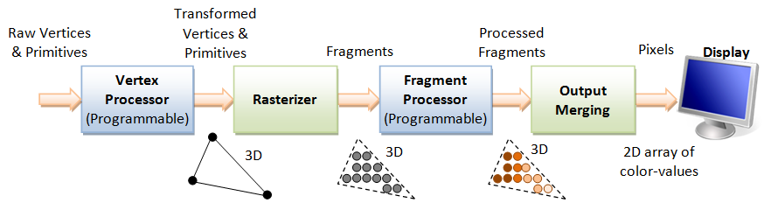
Objectives （课程具体目标）
Broad introduction to Computer Graphics
The generation procedure of a image using a computer (用计算机生成一张图片的过程）
Introduce the details of the key stages of the rendering pipeline
Introduce the details of how to represent or organize a scene

Slide 5
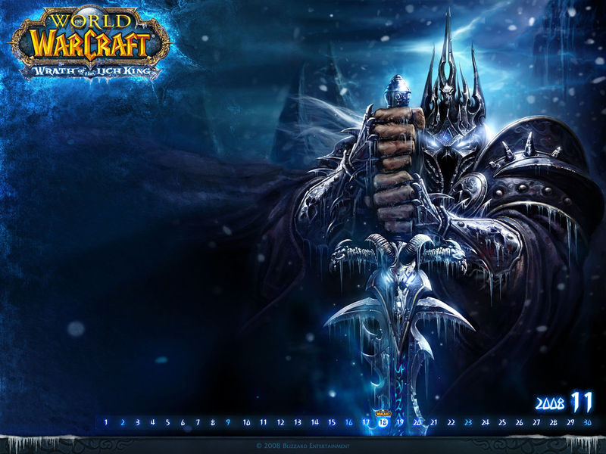
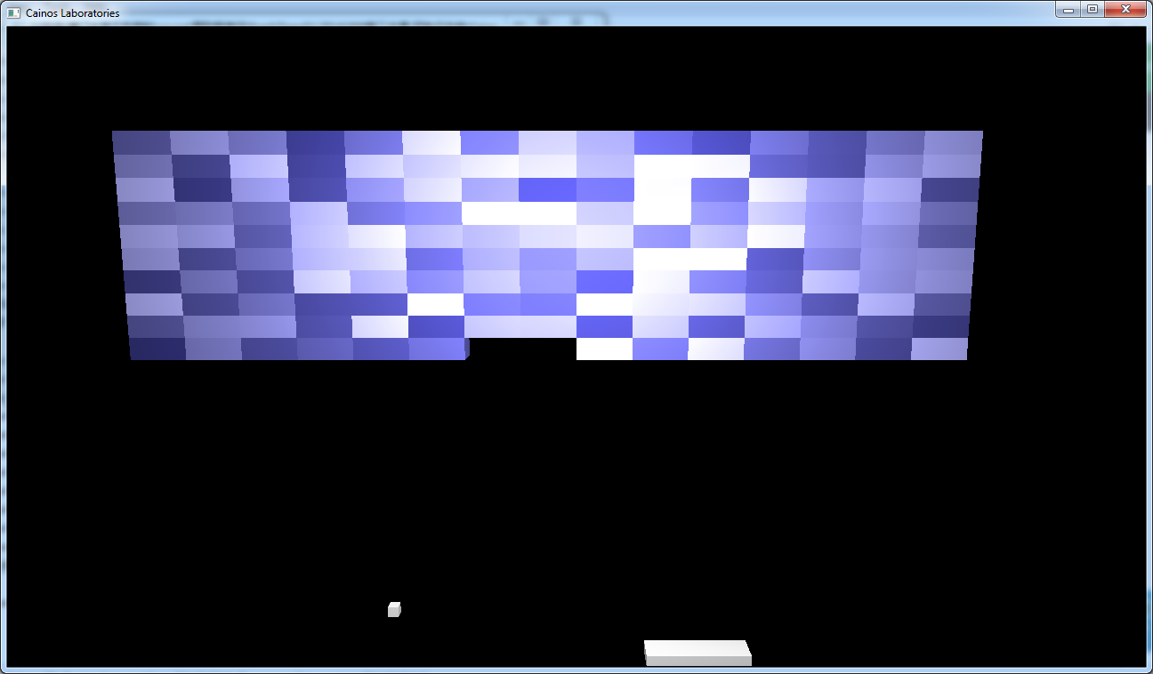
Objectives （课程具体目标）
OpenGL based course
to write a 3D program (怎样写一个3D程序）

Slide 6

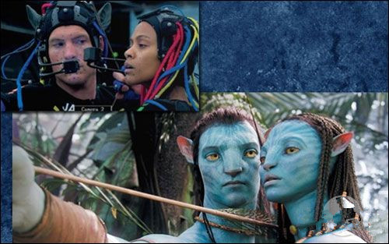
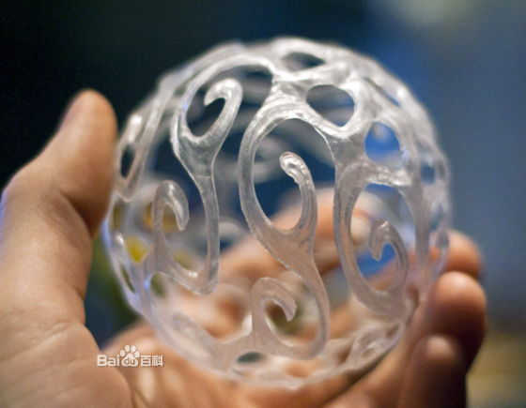
Objectives （课程具体目标）
Introduce the latest techniques on computer graphics
3D Printing
Virtual Reality Glass
3D Movies
…

Slide 7

Prerequisites (先修条件）
Good programming skills in C (or C++)
热爱编程，编程基础扎实
Basic Data Structures （数据结构基础）
Linked lists
Arrays

Slide 8
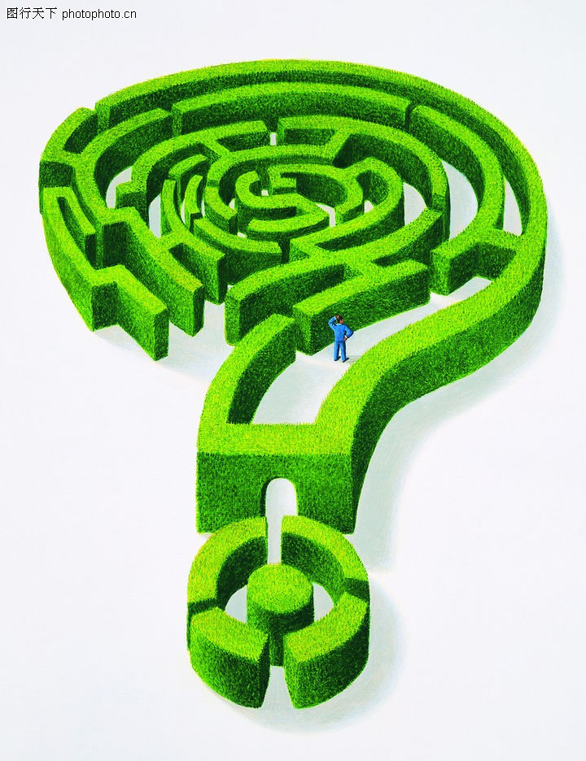
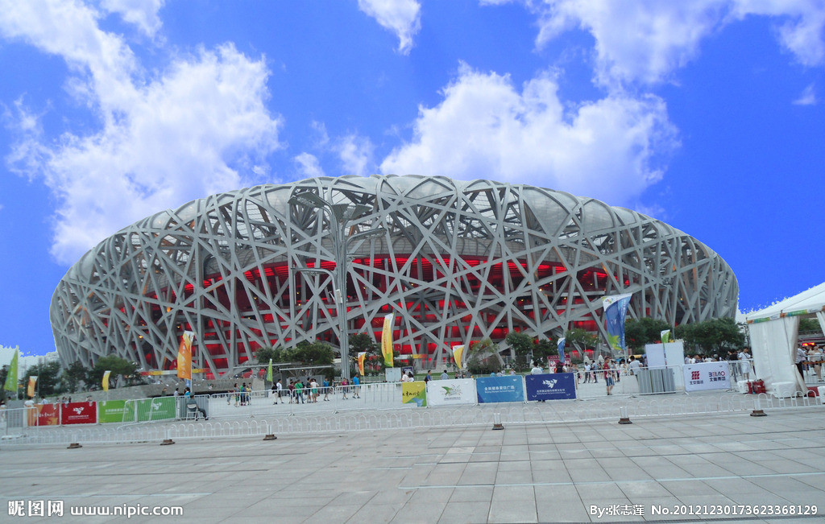
Prerequisites (先修条件）
Geometry （空间几何的直觉）

Slide 9
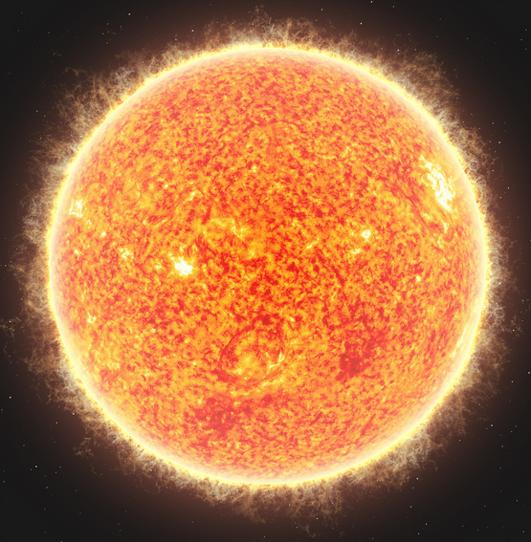
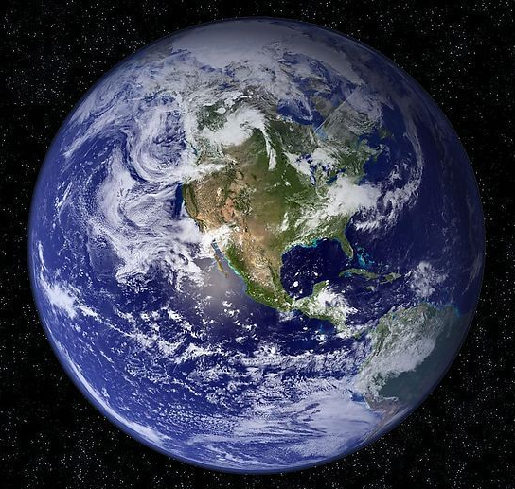

Prerequisites (先修条件）
Solid Linear Algebra （扎实的线代功底）
$$M=[\begin{matrix}? & ? & ? \\ ? & ? & ? \\ ? & ? & ?\end{matrix}]$$

Slide 10
Grading policy (评分标准)
4~6 Experiments 55%
Interactive
3D
Exam: 40%
Attendance 出勤 5%

Slide 11
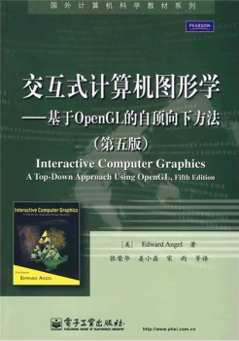
Textbook(教材）
Interactive Computer Graphics - A Top-Down Approach 5th Edition （主教材）
中文版《交互式计算机图形学-基于OpenGL的自顶向下方法》第5版

Slide 12
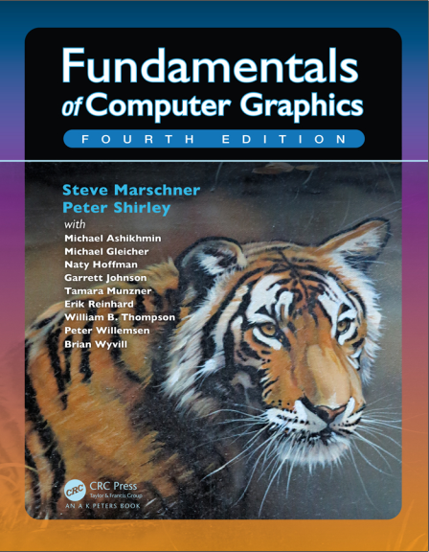
Textbook(教材）
Fundamentals of Computer Graphics 4th Edition （辅助材料）（The Tiger Book）
计算机图形学基础（第四版）

Slide 13
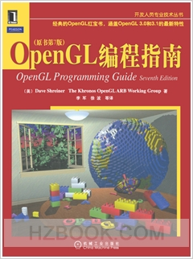
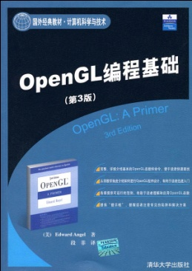
References (参考资料）
The OpenGL Programmer’s Guide (the Redbook) 7th Edition
OpenGL编程指南 第七版 （俗称红宝书）
OpenGL A Primer 3rd Edition
OpenGL编程基础 第三版

Slide 14
Resources
Teaching Ftp
ftp://121.192.180.66/
QQ Group
981151584

Slide 15
Outline: Part 1
Part 1: Introduction
Contents
What is Computer Graphics?
Applications Areas
History
Image formation
Basic Architecture

Slide 16
Outline: Part 2
Part 2: Basic OpenGL
Contents
Architecture
GLUT
Simple programs in two and three dimensions
Interaction

Slide 17
Outline: Part 3
Part 3: Three-Dimensional Graphics
Contents
Geometry
Transformations
Homogeneous Coordinates
Viewing
Lighting and Shading

Slide 18
Outline: Part 4
Part 4: Implementation
Contents
Approaches (object vs image space)
Implementing the pipeline
Clipping
Line drawing
Polygon Fill
Display issues (color)
Implementing a basic raytracer

Slide 19
Outline: Part 5
Part 5: Geometry and Other Graphics Technologies
Bezier Curve
Point Cloud
Mesh
Animation
…

